Slide 1


Nana Voitenko, Coordinator,
Head of Department of Sensory Signaling at
Bogomoletz Institute of physiology (BIPH), Ukraine
Annual meeting 22.06.2020
.
This project has received funding from the European Union’s H2020 Programme for Coordination and support action under grant agreement no 857562.

Slide 2
WP6 - Project Management
Task 6.1. Project Management and Coordination
Task 6.2. Financial Management
Task 6.3. Supervisory Board
Task 6.4. Young Scientists
Task 6.5. Renovation of the seminar room

Slide 3
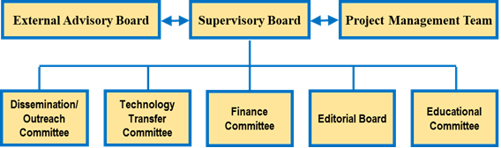
Task 6.1. Project Management and Coordination
Network organization and management structure

Slide 4
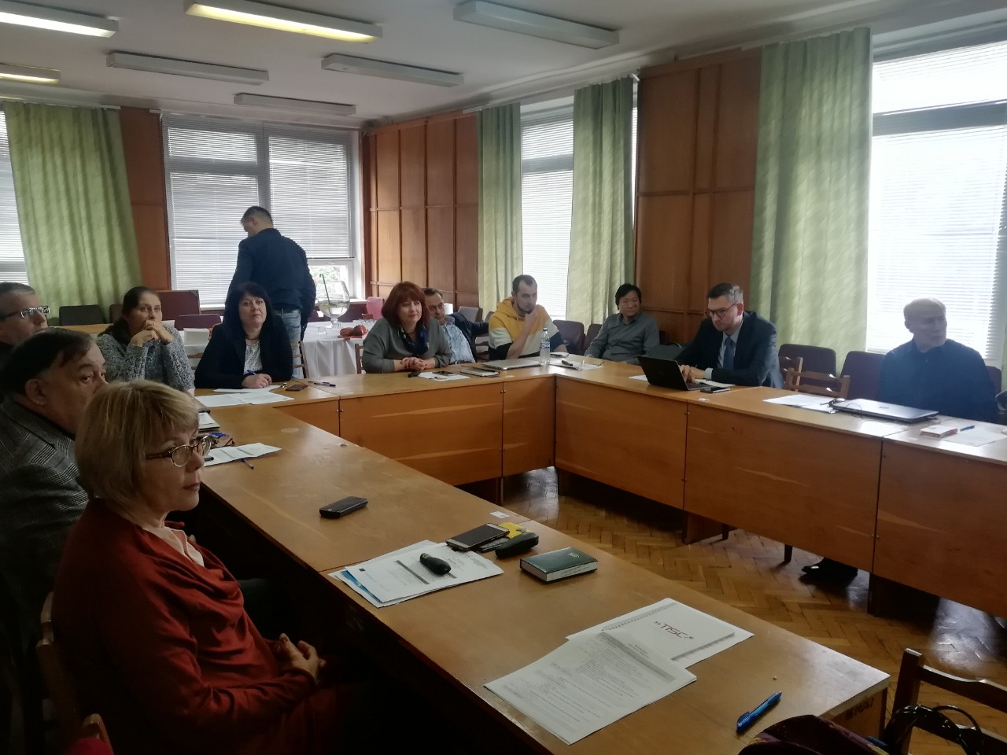
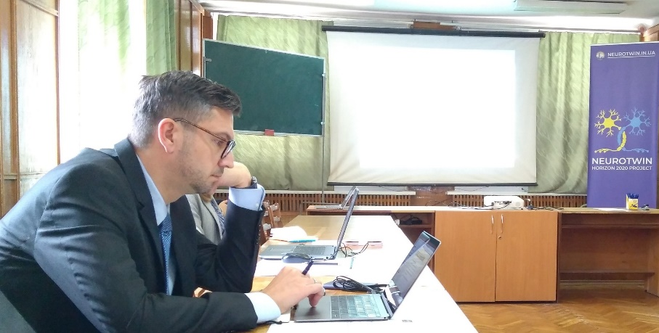
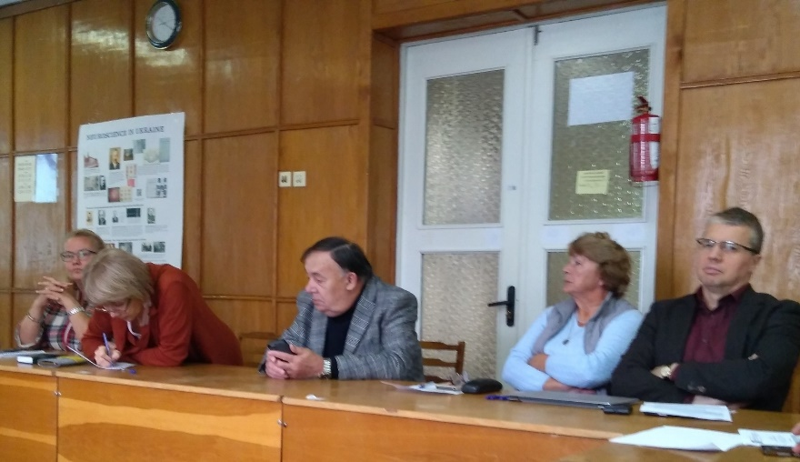
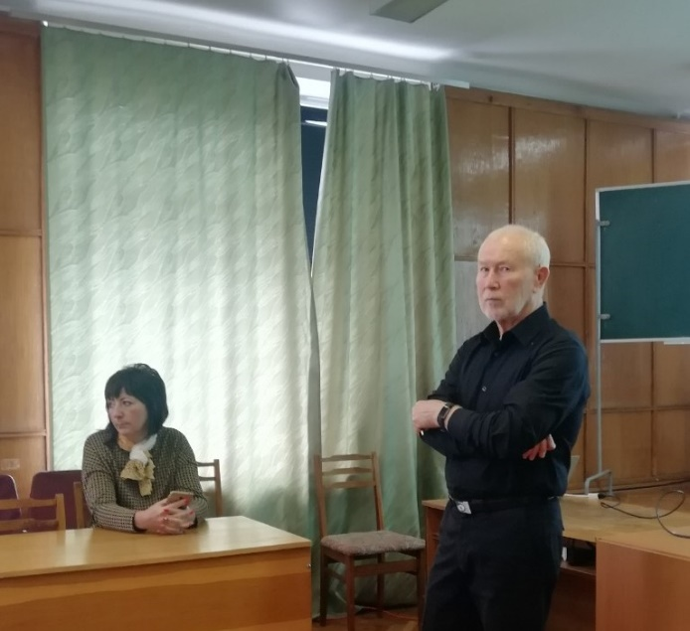
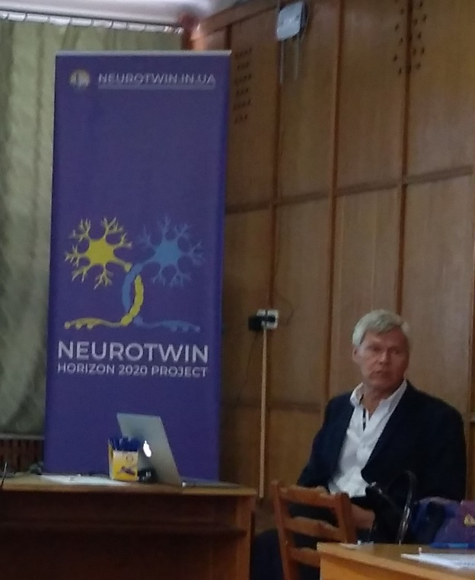
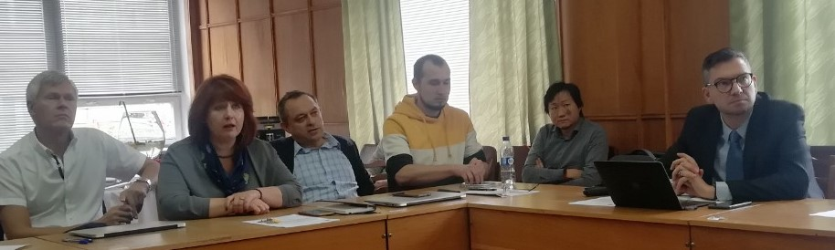
Kick-off meeting, Kyiv, September 2019

Slide 5
Management structure
Supervisory Board of the project comprises all Team Leaders - Nana Voitenko, Dmitri Rusakov, Boris Safronov, Gorazd Weiss, Arthur Konnerth, and Georgy Bakalkin - and chaired by the Project Coordinator.
responsibility for the Consortium
decisions on all aspects of the Project, both strategic and tactical
coordination of educational activities, knowledge transfer, management, communication and dissemination
monitors and controls Project progress and quality
assess risks, legal, ethical, financial and administrative activities
approves financial reports, and set up the dates and agenda for the meetings and worksho
via its Coordinator, makes regular reports to the European Commission,
keep permanent contact with the European Commission to resolve all issues

Slide 6
Management structure
External Advisory Board, consisting of Neuroscience professionals who cover expertise that we do not have in the consortium:
Prof. Alexei Verkhratsky, Chairman of the Physiology and Medicine Section of Academia Europaea, Professor of Neurophysiology at the University of Manchester.
Prof. Yuriy Usachev, John P. Long Professor (Chair), Professor of Pharmacology and Anaesthesia at University of Iowa.
Prof. Marina Bentivoglio, Professor of Histology at the University of Verona, Italy. Secretary General of the International Brain Research Organization (IBRO; 2007-2009) and as President of the Italian Society of Neuroscience (2008-2009).

Slide 7
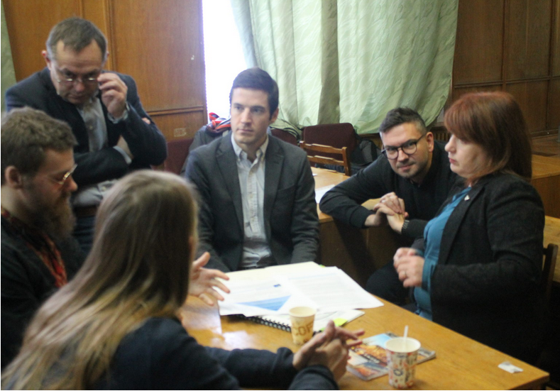
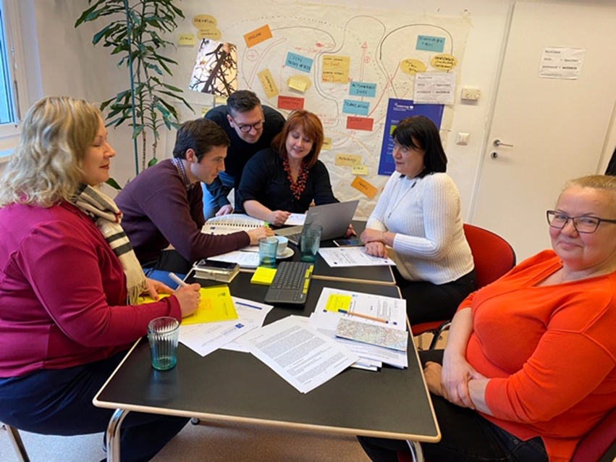
Management structure
Project Management Team, consisting of the project coordinator - Nana Voitenko (BIPH), project manager – Svetlana Ivanova (BIPH), Ilona Chencova (BIPH), technical assistance – Yevgeniy Sheremet, Andrey Dromaretskiy, Vasyl Yatsenko, Lyudmila Palivoda (BIPH). This Team is responsible for overall management, ensuring that project is successfully managed and its objectives achieved and will ensure communication between the Partners.
PGM staff Training Workshop, Part I - December 3, 2019 – Kyiv
PGM staff Training Workshop, Part II - December 15-16, 2019 – Vienna

Slide 8
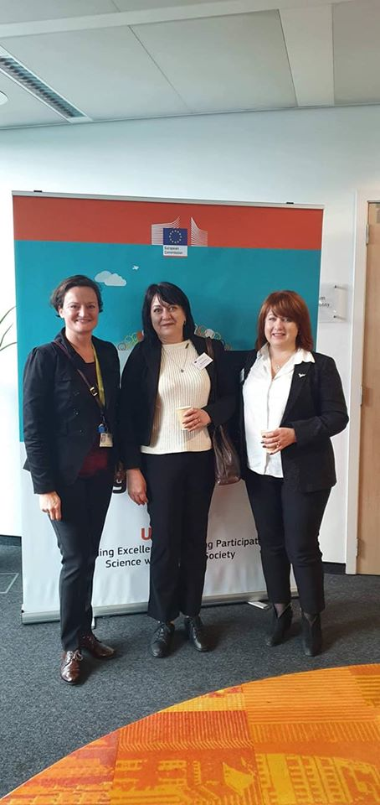
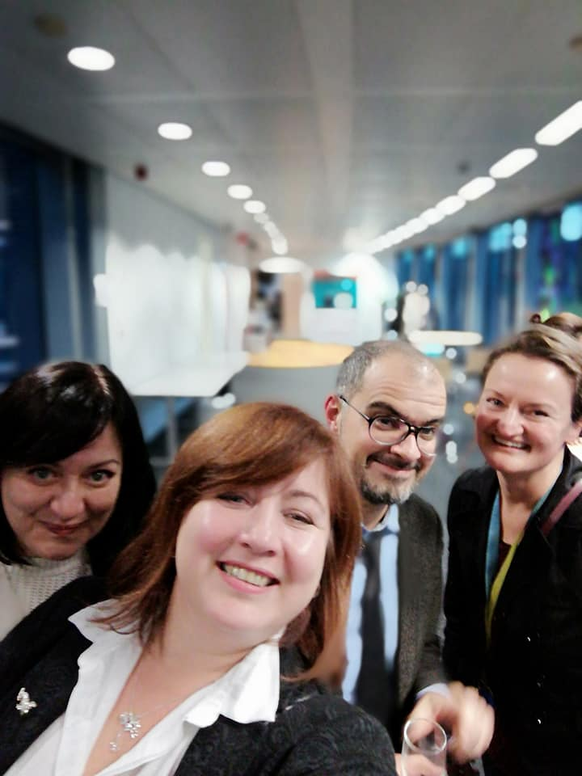
Coordinators’ Meetings in Brussels
WIDENING DAY 2019, 12, 13 November 2019
TWINNING Coordinators Day, 14 November 2019
Project Adviser
Pepa Krasteva
Marta Muter

Slide 9
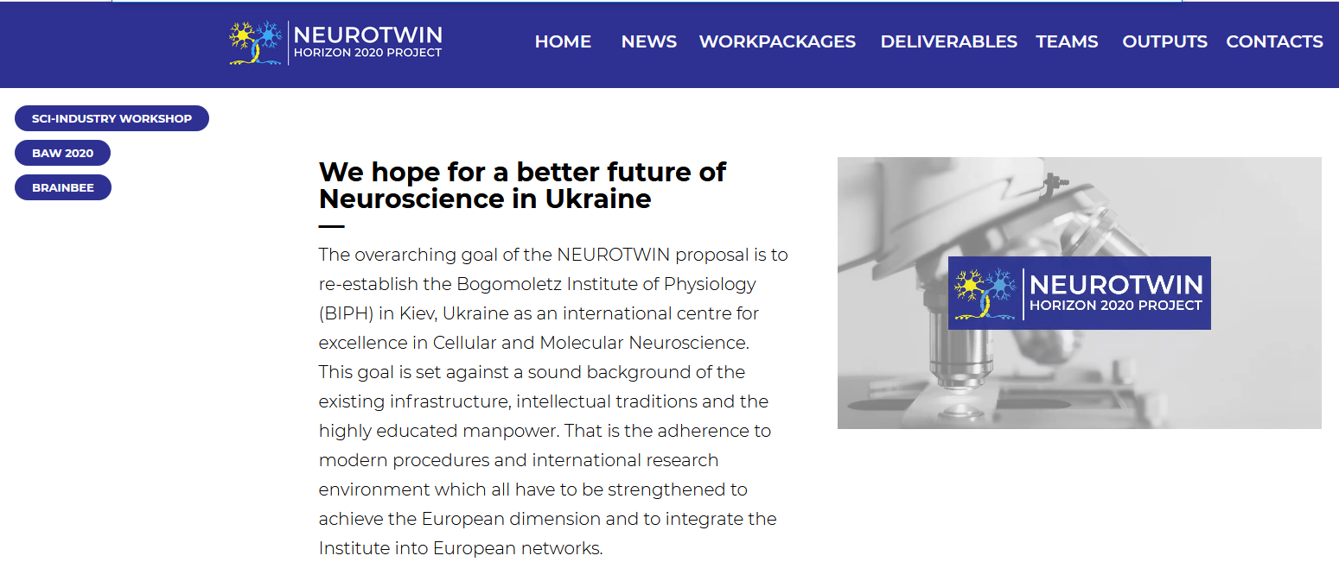
Management structure
Dissemination/Communication Committee, Chair – Gorazd Weiss (ZSI), Members - Philipp Brugner (ZSI), Andrey Kostyuk (BIPH), Oleksiy Boldyrev (BIPH). This committee ensures that the activities described in Section 2.2 are implemented by all of the Partners. In particular, the Committee is responsible for the development of Communication/Dissemination/Exploitation Plan (WP5) and its implementation in the project.
NEUROTWIN Website: neurotwin.in.ua

Slide 10
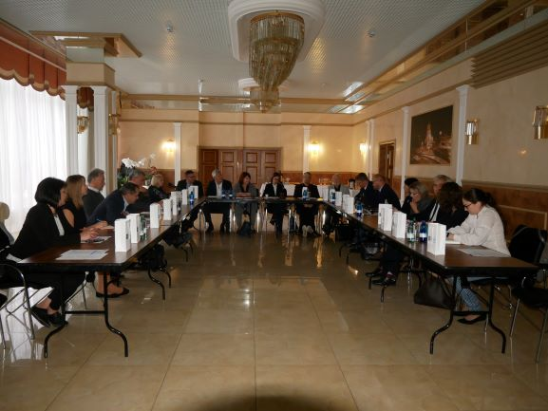
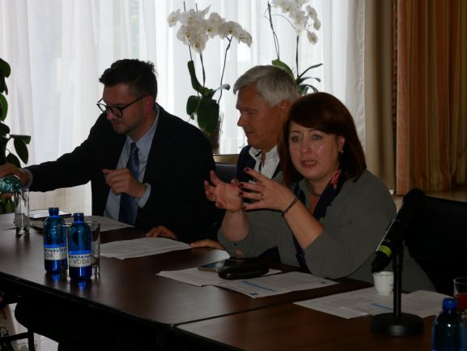
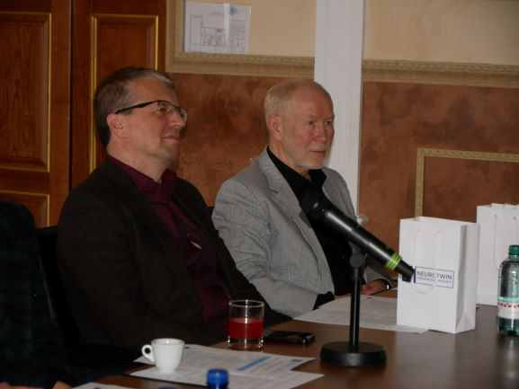
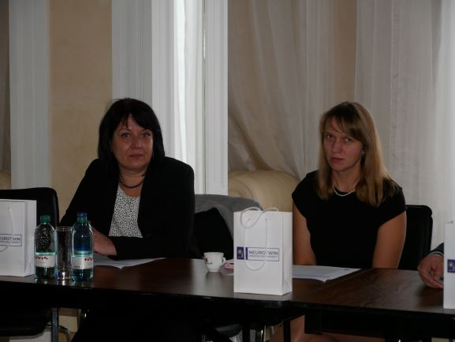
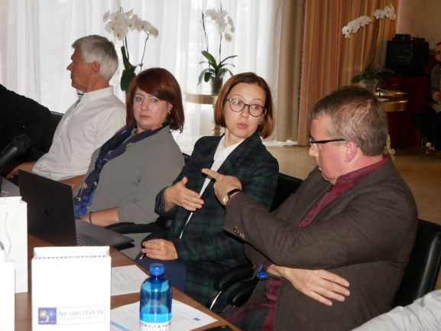
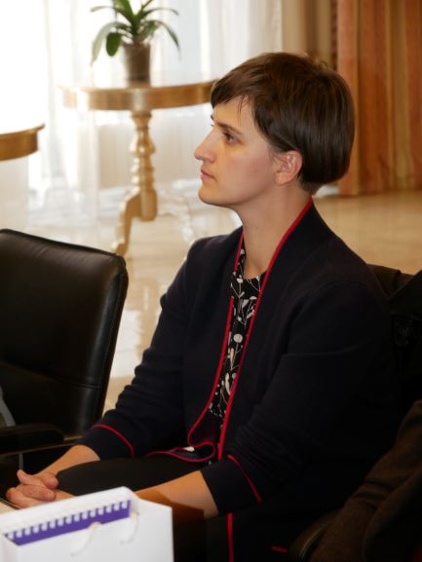
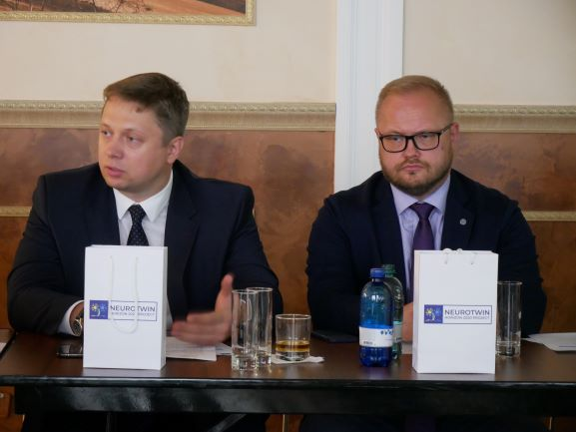
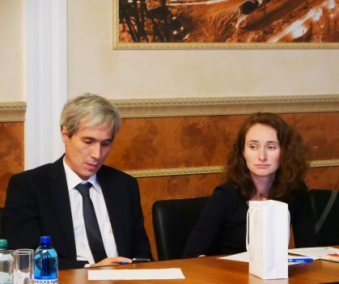
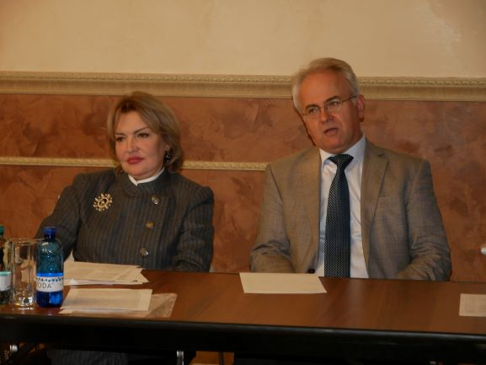
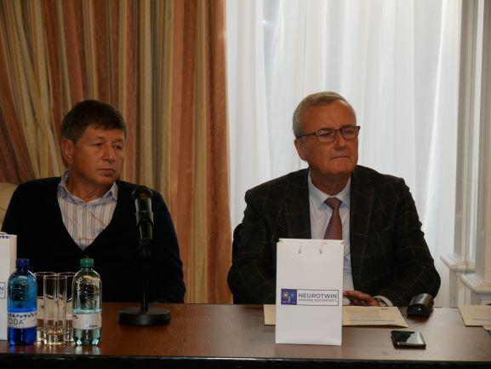
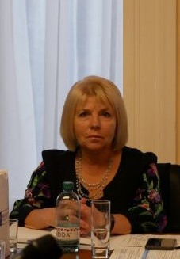
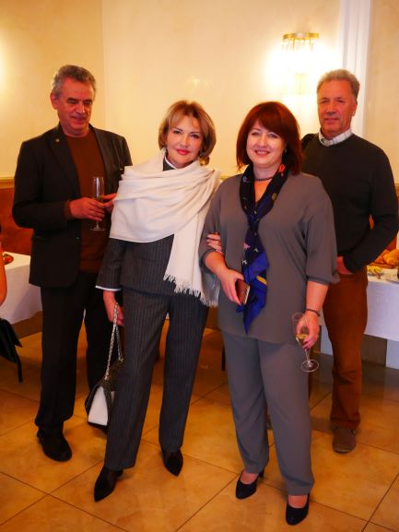
Policy-makers meeting, Kyiv, September 2019

Slide 11
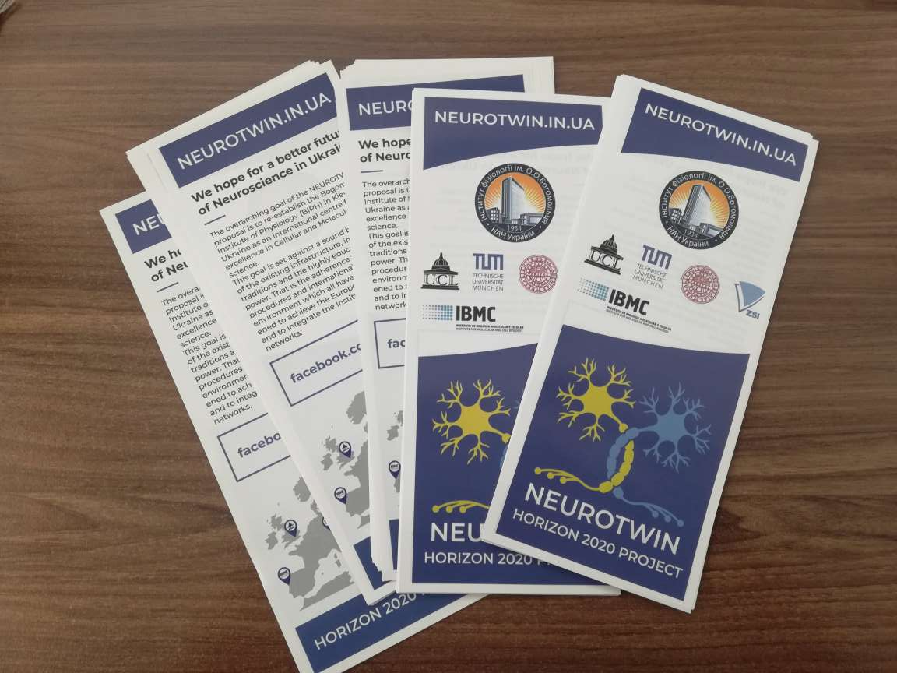
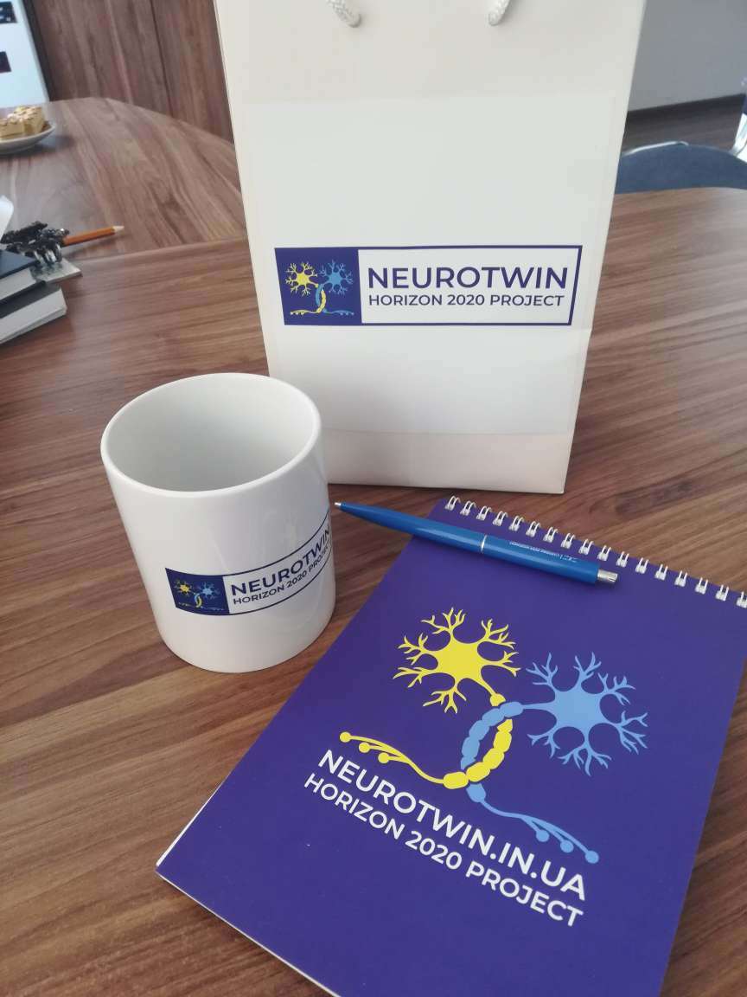
Disseminating materials

Slide 12
Management structure
Knowledge and Technology Transfer Committee, Chair – Georgy Bakalkin (UU), members – Pavel Belan (BIPH), Alyona Borovskaya (BIPH). This committee monitors and evaluates the progress of transfer of knowledge, methodology and current approaches.
Knowledge Transfer Workshop was held on October 2 - 4 in Kyiv
The Science-Industry Workshop scheduled for March 28, 2020, due to restrictions on mass events in connection with the spread of coronavirus disease COVID-19 was postponed for after quarantine time.

Slide 13
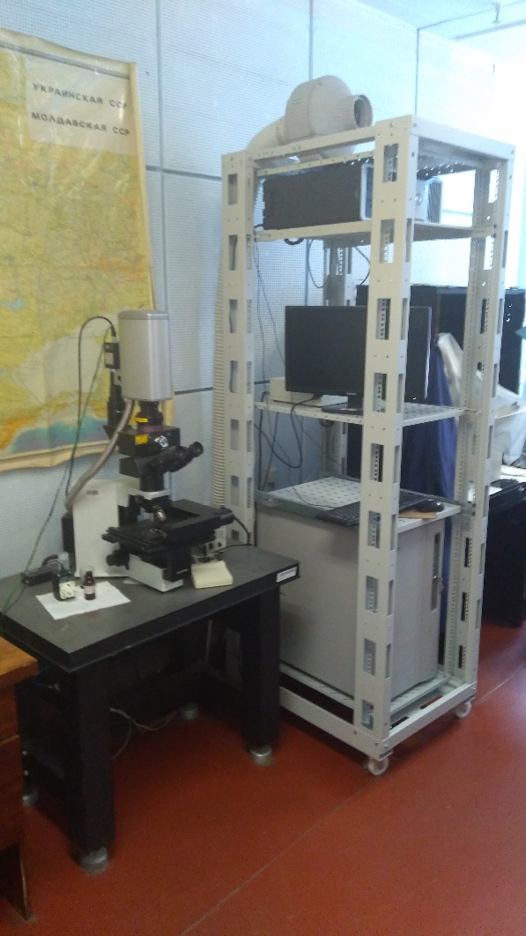
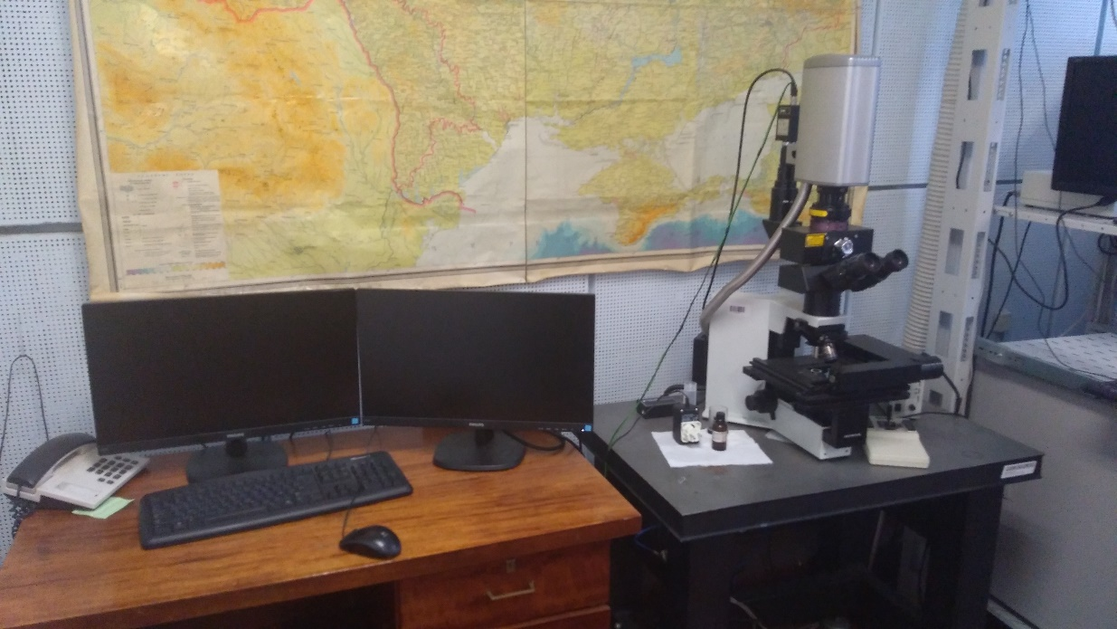
Knowledge and Technology Transfer
Prof. Rusakov from the UCL kindly gifted to the BIPH the two-photon/confocal Biorad Radiance 2100-2PE microscope. It is now a part of the Optical Core Facilities located in the BIP Neuroscience Division and is available for the BIP researchers who were trained via the knowledge transfer within the Project due to efforts of Dr. Kaiyu Zheng from UCL. This action has widen the BIP staff expertise in imaging techniques and strongly enhance the BIP S&T capacity.

Slide 14
Management structure
Finance Committee, Chair – Boris Safromov (IBMC), members - Nataliya Lata, (BIPH), Pavel Belan (BIPH), Svetlana Ivanova (BIPH).
PGM staff Training Workshop, Part I - December 2nd, 2019 – Kyiv
Financial management of EU Funded projects – Gorazd Weiss (ZSI)
• H2020 financial issues
` Contract and financial management
• H2020 financial rules
• Types of eligible costs
• Financial reporting
• Setting up the templates for the internal financial reporting
• Online reporting “Funding & tenders portal”
PARTICIPANTS: BIPH financial staff (accountancy department) and project staff – grant office

Slide 15
Management structure
Editorial Group, Chair – Dmitri Rusakov (UCL), members – Boris Safronov (IBCM), Georgy Bakalkin (UU), Pavel Belan (BIPH), Yaroslav Shuba (BIPH).
SCIENTIFIC WRITING WORKSHOP, Kyiv October 1st
Manuscript design: non-trivial challenges in common issues (Georgy Bakalkin)
What should be avoided when writing manuscripts (Boris Safronov)
Web of Science Group resources for analyzing scientific data and manuscript preparation (Iryna Tykhonkova)
PAPER CONTEST
for the best publication for 2017-2020 in the field of Cellular and Molecular Neuroscience. The winner of the competition will receive a grant to participate in any European conference on neuroscience of his / her choice. (Deadline - August 31, 2020. The winner will be announced on October 10, 2020.)
FENS FORUM CONTEST
4 BIPH young scientists, who received travel grants from FENS, also received coverage of abstract fee from NEUROTWIN

Slide 16
Management structure
Educational Committee, Chair – Arthur Konnerth (TUM), members – Boris Safronov (IBCM), Bezhan Sharopov (BIPH), Andrii Cherninskyi (BIPH), Olga Lyubanova (BIPH). Role is to ensure the effective promotion of neuroscience for undergraduate and graduate students with their future recruiting to Master and PhD neuroscience programs at BIP, training MSc and PhD students at BIP for state-of-the-art methods in a field of neuroscience, organization of competitions.
Postponed:
Biophysical Methods in Neuroscience Student Workshop
Canceled for 2020:
GA-BIPH Summer School

Slide 17
Task 6.2. Financial Management
Organisation of a sound financial, administrative and contractual project management. Financial Aspects of the Programme will be governed by the programme Financial Committee (months 1-36).
The Consortium Agreement with Participants using the DESCA template was drawn up (month 1).
The template for financial report was created by ZSI and will be distributed among Participants before the 1st financial report (month 18)
PGM staff Training Workshop, Part I, December 2nd 2019, Kyiv (Gorazd Weiss)

Slide 18
Task 6.3. Supervisory Board
Project steering with the objective to implement the project in a smooth and consolidated way, involving the Partnership, Supervisory Board and external stakeholders whenever appropriate in an optimum way.
Kick-off meeting, Kyiv, September 2019
Policy-makers meeting, Kyiv, September 2019
Proposal Writing Workshop , Kyiv, October 2019
Scientific Writing Workshop , Kyiv, October 2019
Knowledge Transfer Workshop, Kyiv, October 2019
Coordinators’ Meetings, Brussels, November 2019
PGM staff Training Workshop I, Kyiv, November 2019
PGM staff Training Workshop II, Vienna, November 2019
Neuroscience Online, April-June, 2020
Responsible Partner: BIPH. Participating Partners: All Participants

Slide 19
Task 6.4. Young Scientists
Delegation of responsibilities to young scientists.
Supervisory Board, Project Management Team and Financial Committee are in strong collaboration with BIPH Young Scientist Council in moderation of agendas and content of practical courses for Workshops and Summer Schools; choosing delegates for attending meetings and conferences; winners of contests. A head of BIPH Young Scientist Council, Dr. Bizhan Sharopov, and team of MS, PhD students and young scientists are actively participate in all Communication activities related to Brain Awareness Week and Days of Science.
Paper Contest
Fens Forum Contest
Neuroscience Online
Responsible Partner: BIPH. Participating Partners: All Participants.

Slide 20
Task 6.5. Renovation of the seminar room
Training, dissemination and communication during the implementation of the project require a good quality presentation room having installed necessary modern demonstration, communication and recording equipment. The Neuroscience Division of BIP has its own seminar room that can fit up to 50 people. This room is perfectly suited for the most activities in the framework of the project including lectures, seminars, workshops, communication with legislators, governmental officers and industrial stakeholders. Unfortunately, this room has not been renovated for 25 years. In order to create necessary conditions for training, dissemination and communication we have started to remodel the seminar room and to install in this room modern demonstration, communication and recording equipment (from indirect costs). Unfortunately, we could not finish this renovation due to quarantine, but plan to finish it till the end of July.
Responsible Participant: BIPH. Participating Partners: BIPH.

Slide 21
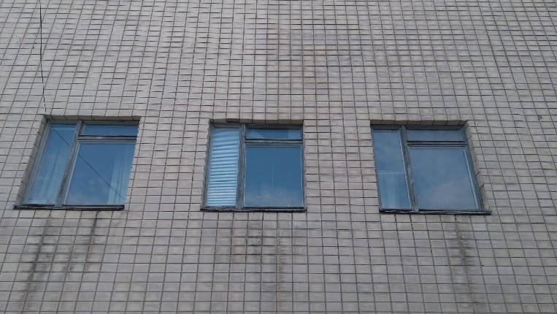
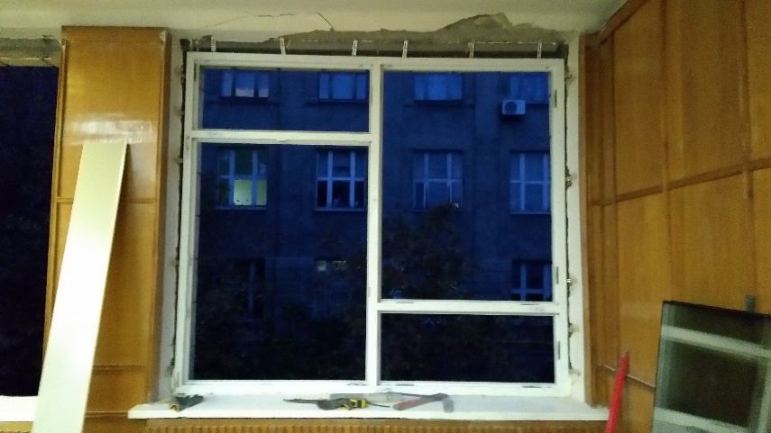
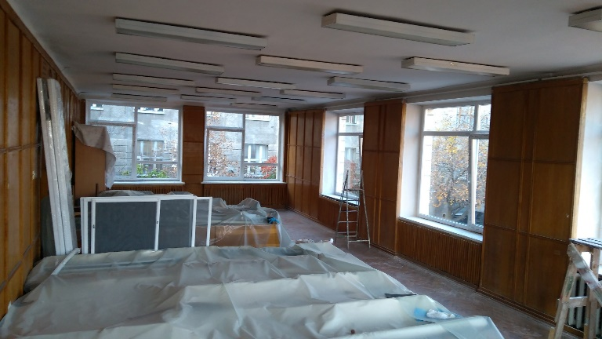
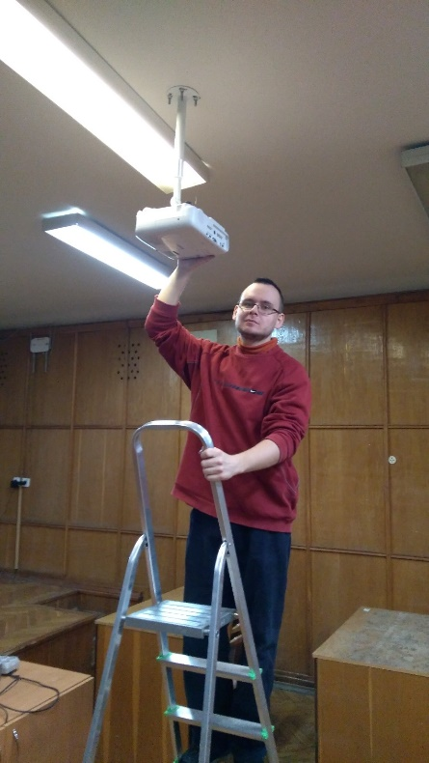
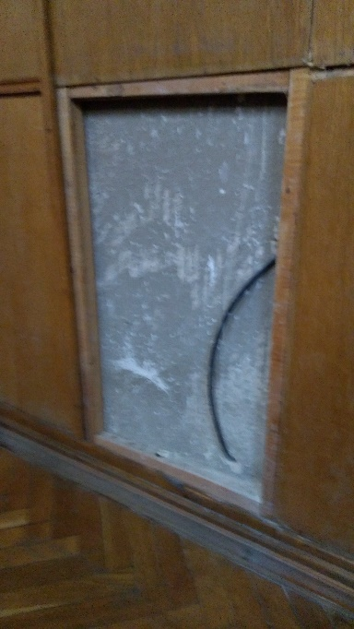
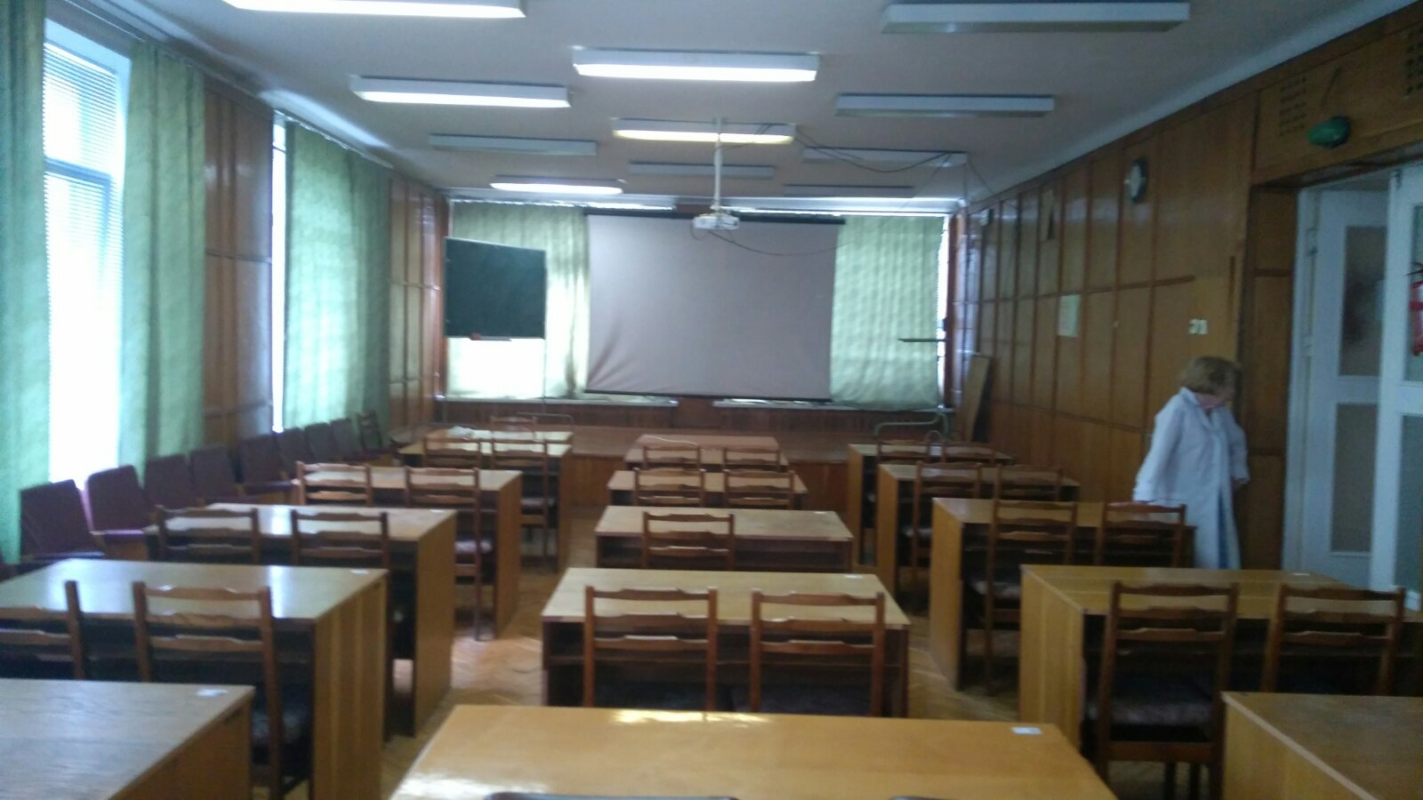
Renovation of the seminar room

Slide 22
THANKS

